Slide 1
Data Structures

Slide 2
Contents
Data
Data Structures
Classification of Data Structures
Operations on Data Structures
Selecting a Data Structure
Algorithm
Definition
Usage

Slide 3
Before we start, Let us answer these questions:
How many cities with more than 50,000 people lie within 300 miles of Tashkent.
How many international phone calls being made between Delhi and Tashkent every Friday evening.
How many people in Tashkent earning more than 1000 USD per month in business.
To answer these type of questions, it is not enough to have necessary information……….
We must organize that information in a way that allows us to find the answers in time to satisfy our needs

Slide 4
Representing information is fundamental to computer science.
The primary purpose of most computer programs is not to perform calculations, but to store and retrieve information — usually as fast as possible.
the study of data structures and the algorithms that manipulate them is at the heart of computer science.

Slide 5
Data
“Data are simply value or set of values”
e.g. name = “George”
Age=56, sex= male, passport_No.=K236598……
Data items refers to a single unit of value. It specifies either a value of variable or constant.
A data type is a collection of values and set of operations that act on those values.
-set of values
-set of operations
For example,
an integer variable is a member of the integer data type.
-2,147,483,648 to 2,147,483,647 (in C language)
Addition is an example of an operation on the integer data type.

Slide 6
Data structure:
usually refers to an organization for data in main memory.
File structure:
an organization for data on peripheral storage, such as a disk drive or tape.

Slide 7
computer program design have two goals:
1. To design an algorithm that is easy to understand, code, and debug.
2. To design an algorithm that makes efficient use of the computer’s resources
The choice of data structure and algorithm can make the difference between a program running in a few seconds or many days.
A solution is said to be efficient if it solves the problem within its resource constraints.
space
time
The cost of a solution is the amount of resources that the solution consumes.

Slide 8
Each data structure has costs and benefits.
A data structure requires:
space for each data item it stores
time to perform each basic operation
programming effort.
Each problem has constraints on available space and time.
Only after a careful analysis of problem characteristics can we know the best data structure for the task.
Bank example:
Start account: a few minutes
Transactions: a few seconds
Close account: overnight

Slide 9
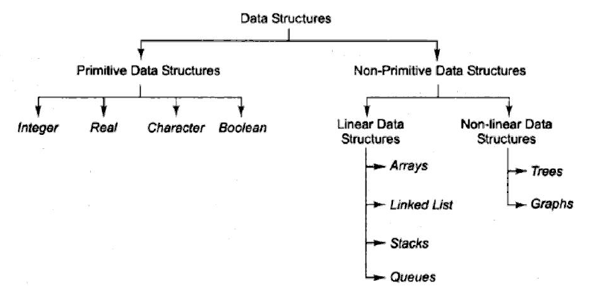
Classification of Data Structures

Slide 10
Operations on Data Structures
Traversing
Searching
Inserting
Deleting
Sorting
Merging

Slide 11
Selection of Data Structure
The choice of particular data model depends on two consideration:
It must be rich enough in structure to represent the relationship between data elements
(Ex. linear relationship Vs nonlinear rltnshp)
The structure should be simple enough that one can effectively process the data when necessary
(Ex. linear relationship in Arry Vs Linked List)

Slide 12
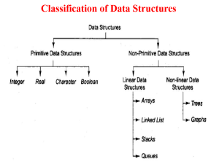

Following steps must be performed while selecting data structures:
Analysis of the problem to determine basic operations that must be supported. ( ex. Finding max(heap), adding data in sorted list (linked list), etc.)
Quantify the resource constraints for each operation. (ex. extra space for address fields, dynamic allocation, time to access data)
Select the data structure that best meets these requirements.
As a programmer it is mandatory to choose most appropriate data structures for a program.

Slide 13
Problems, Algorithms, and Programs
Problems
A problem is a task to be performed.
It is best thought of in terms of inputs and matching outputs.
The solution method should be developed only after the problem is precisely defined and thoroughly understood.
Problems can be viewed as functions in the mathematical sense.
A function is a matching between inputs (the domain) and outputs (the range).
Notes:
Function represent a scenario – which describes input and also the expected output.

Slide 14
Algorithms
An algorithm is a method or a process followed to solve a problem.
A problem can be solved by many different algorithms. A given algorithm solves only one problem

Slide 15
An algorithm possesses several properties
It must be correct.
must compute the desired function, converting each input to the correct output.
2. It is composed of a series of concrete steps.
Concrete means that the action described by that step is completely understood — and achievable — by the person or machine that must perform the algorithm.
3. There can be no ambiguity
as to which step will be performed next. Often it is the next step of the algorithm description
4. It must be composed of a finite number of steps.
If the description for the algorithm were made up of an infinite number of steps, we could never hope to write it down, nor implement it as a computer program.
5. It must terminate.
In other words, it may not go into an infinite loop.

Slide 16
Programs
Programs: computer program is a representation, of an algorithm in some programming language.
Normally the terms “algorithm” and “program” interchangeably are used, despite the fact that they are really separate concepts.
By definition, an algorithm must provide sufficient detail that it can be converted into a program when needed.

Slide 17
To summarize:
A problem is a function or a mapping of inputs to outputs.
An algorithm is a recipe for solving a problem whose steps are concrete and unambiguous.
The algorithm must be correct, of finite length, and must terminate for all inputs.
A program is an instantiation of an algorithm in a computer programming language.

Slide 18
Abstract Data Type (ADT)
An ADT describes a set of objects sharing the same properties and behaviors
The properties of an ADT are its data
The behaviors of an ADT are its operations or functions
an ADT couples its data and operations
OOP emphasizes data abstraction
Encapsulation: Binding together
Abstraction : hide implementation details.
A data structure is the physical implementation of an ADT.
Notes:
Abstraction is the method of hiding the unwanted information. Whereas encapsulation is a method to hide the data in a single entity or unit along with a method to protect information from outside. ... Whereas encapsulation can be implemented using by access modifier i.e. private, protected and public.

Slide 19
ADT is a data type, where only behaviour is defined but not implementation. Examples: Array, List, Map, Queue, Set, Stack, Table, Tree, and Vector are ADTs
The ADT is made of with primitive datatypes, but operation logics are hidden.
ADT is a logical description of how we view the data and the operations that are allowed without regard to how they will be implemented.
What is an ADT in C++? It is a class that has a defined set of operations and values.

Slide 20
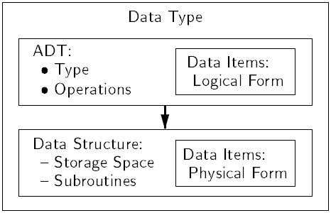
Logical vs. Physical Form
Data items have both a logical and a physical form.
Logical form:
definition of the data item within an ADT.
Physical form:
implementation of the data item within a data structure.

Slide 21
Asymptotic Notation

Slide 22
Asymptotic Complexity
(Expressed using Asymptotic Notation)
Running time of an algorithm as a function of input size n for large n.
Expressed using only the highest-order term in the expression for the exact running time.
Instead of exact running time, say Θ(n²).
Describes behavior of function in the limit.

Slide 23
Asymptotic Notation
Θ, O, Ω,
Defined for functions over the natural numbers.
Ex: f(n) = Θ(n²).
Describes how f(n) grows in comparison to n².
Define a set of functions;
in practice used to compare two function sizes.
The notations describe different rate-of-growth relations between the defining function and the defined set of functions.

Slide 24
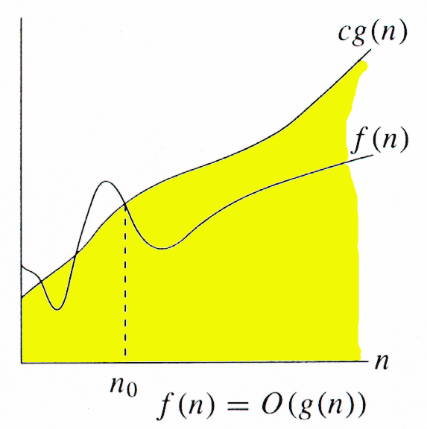
O-notation
For function g(n), we define O(g(n)), big-O of n, as the set:
O(g(n)) = {f(n) : ∃ positive constants c and n_{0,} such that ∀n ≥ n₀,
we have 0 ≤ f(n) ≤ cg(n) }
Intuitively: Set of all functions whose rate of growth is the same as or lower than that of g(n).
g(n) is an asymptotic upper bound for f(n).
f(n) = Θ(g(n)) ⇒ f(n) = O(g(n)).
Θ(g(n)) ⊂ O(g(n)).

Slide 25
Examples
O(g(n)) = {f(n) : ∃ positive constants c and n₀, such that ∀n ≥ n₀, we have 0 ≤ f(n) ≤ cg(n) }
Any linear function an + b is in O(n²). How?
Show that 3n³=O(n⁴) for appropriate c and n₀.
Notes:
This is not tight bound as we can have smaller function that also satisfies the big oh relation.

Slide 26
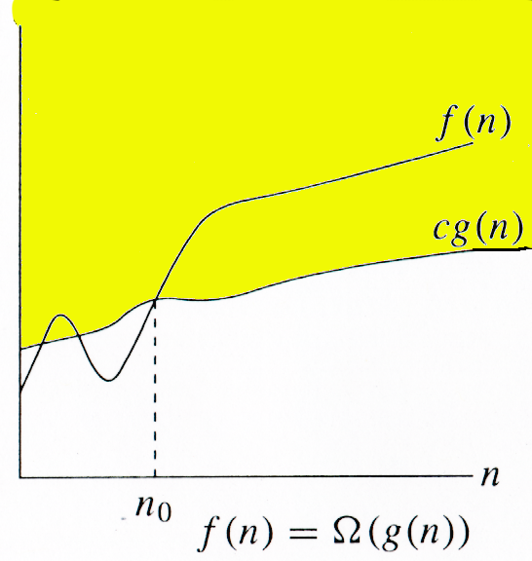
Ω -notation
For function g(n), we define Ω(g(n)), big-Omega of n, as the set:
Ω(g(n)) = {f(n) : ∃ positive constants c and n_{0,} such that ∀n ≥ n₀,
we have 0 ≤ cg(n) ≤ f(n)}
Intuitively: Set of all functions whose rate of growth is the same as or higher than that of g(n).
g(n) is an asymptotic lower bound for f(n).
f(n) = Θ(g(n)) ⇒ f(n) = Ω(g(n)).
Θ(g(n)) ⊂ Ω(g(n)).

Slide 27
Example
Ω(g(n)) = {f(n) : ∃ positive constants c and n₀, such that ∀n ≥ n₀, we have 0 ≤ cg(n) ≤ f(n)}
n³+2n = Ω(n). Choose c and n₀.

Slide 28
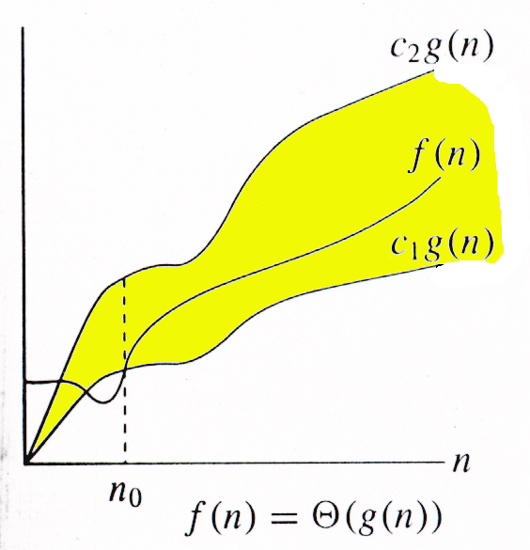
Θ-notation
For function g(n), we define Θ(g(n)), big-Theta of n, as the set:
Θ(g(n)) = {f(n) : ∃ positive constants c₁, c₂, and n_{0,} such that ∀n ≥ n₀,
we have 0 ≤ c₁g(n) ≤ f(n) ≤ c₂g(n)
}
Intuitively: Set of all functions that have the same rate of growth as g(n).
g(n) is an asymptotically tight bound for f(n).

Slide 29
Example
Θ(g(n)) = {f(n) : ∃ positive constants c₁, c₂, and n₀, such that ∀n ≥ n₀, 0 ≤ c₁g(n) ≤ f(n) ≤ c₂g(n)}
10n² - 3n = Θ(n²)
What constants for n₀, c₁, and c₂ will work?
Make c₁ a little smaller than the leading coefficient, and c₂ a little bigger.
To compare orders of growth, look at the leading term.

Slide 30
Video Lecture of the topic can be found at
Introduction to DATA STRUCTURES
https://youtu.be/AtMUVr3X6H8
Data Structures - Abstract Data Types
https://youtu.be/y58iGerTlt8

